Slide 1
Example: Convert 43.7 kilowatts into watts
Quantity in kilowatts
43.7 kW
The quantity inside the box must remain the same
Quantity in watts

Slide 2
Example: Convert 43.7 kilowatts into watts
Quantity in kilowatts
43.7 kW
The quantity inside the box must remain the same
1. Watts are 1 000 times smaller than kilowatts
43 700 W
Quantity in watts

Slide 3
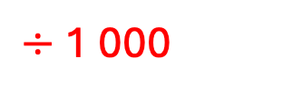
Example: Convert 43.7 kilowatts into watts
Quantity in kilowatts
43.7 kW
The quantity inside the box must remain the same
$÷$1 000
1. Watts are 1 000 times smaller than kilowatts
43 700 W
Quantity in watts

Slide 4
Example: Convert 43.7 kilowatts into watts
Quantity in kilowatts
43.7 kW
The quantity inside the box must remain the same
$÷$1 000
2. To compensate for making the unit smaller, we must make the number larger
1. Watts are 1 000 times smaller than kilowatts
43 700 W
Quantity in watts

Slide 5

Example: Convert 43.7 kilowatts into watts
Quantity in kilowatts
43.7 kW
The quantity inside the box must remain the same
$÷$1 000
2. To compensate for making the unit smaller, we must make the number larger
$× 1 000$
1. Watts are 1 000 times smaller than kilowatts
43 700 W
Quantity in watts

Slide 6
Example: Convert 43.7 kilowatts into watts
Quantity in kilowatts
43.7 kW
The quantity inside the box must remain the same
$÷$1 000
2. To compensate for making the unit smaller, we must make the number larger
$× 1 000$
1. Watts are 1 000 times smaller than kilowatts
43 700 W
Quantity in watts

Slide 7
Example: Convert 43.7 kilowatts into watts
Quantity in kilowatts
43.7 kW
The quantity inside the box must remain the same
43 700 W
Quantity in watts

Slide 8
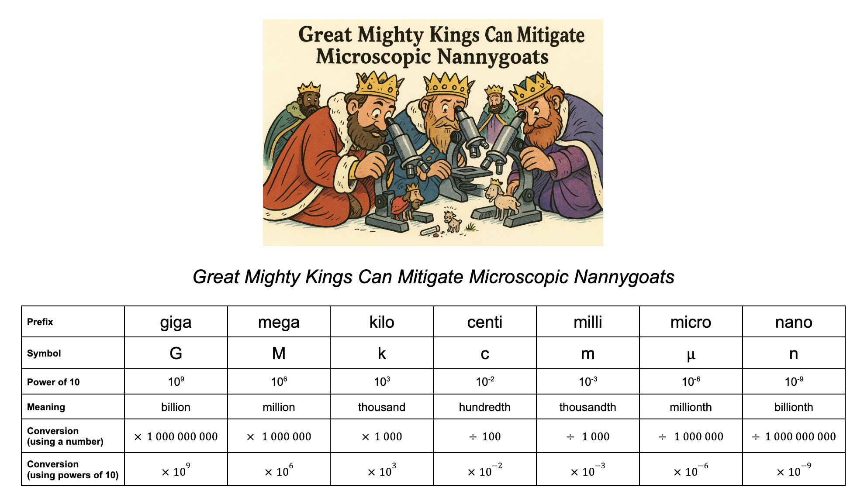
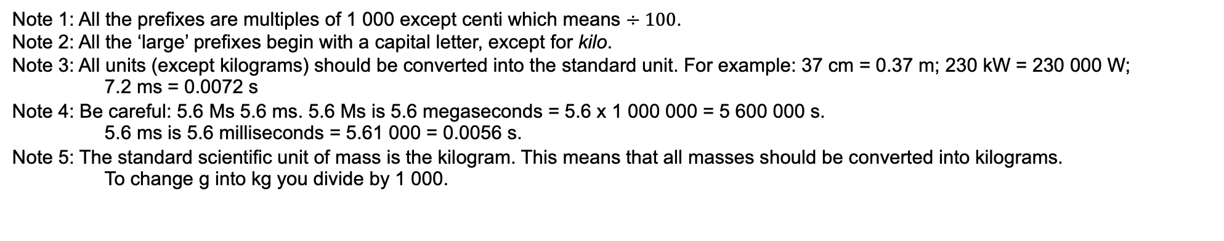
large
small
Note 1: All the prefixes are multiples of 1 000 except centi which means $÷100$.
Note 2: All the ‘large’ prefixes begin with a capital letter, except for kilo.
Note 3: All units (except kilograms) should be converted into the standard unit. For example: 37 cm = 0.37 m; 230 kW = 230 000 W;
7.2 ms = 0.0072 s
Note 4: Be careful: 5.6 Ms 5.6 ms. 5.6 Ms is 5.6 megaseconds = 5.6 x 1 000 000 = 5 600 000 s.
5.6 ms is 5.6 milliseconds = 5.61 000 = 0.0056 s.
Note 5: The standard scientific unit of mass is the kilogram. This means that all masses should be converted into kilograms.
To change g into kg you divide by 1 000.

