Slide 1
Q1. What is the resultant displacement of 3 m north and 4 m east?
Q2. What is the resultant displacement of 4 km north and 3 km east?
N
5.0 m on a bearing of 53 degrees
5.0 km on a bearing of 37 degrees
Q3. What is the resultant displacement of 500 m north and 700 m east?
Q4. What is the resultant displacement of 800 m east and 500 m south?
860 m on a bearing of 54 degrees
940 m on a bearing of 122 degrees

Slide 2
Q5. What is the resultant displacement of 3 m south and 4 m west?
Q6. What is the resultant displacement of 5 km west and 4 km north?
N
6.4 km on a bearing of 309 degrees
5.0 m on a bearing of 233 degrees
Q7. What is the resultant displacement of 700 m on a compass bearing of 045 degrees and 400 m east?
Q8. What is the resultant displacement of 800 m on a compass bearing of 60 degrees and 400 m east?
690 m on a bearing of 047 degrees
1160 m on a bearing of 71 degrees

Slide 3
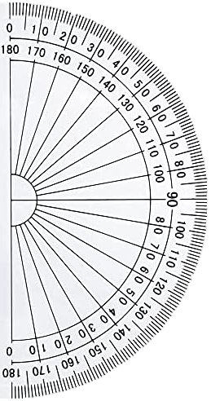
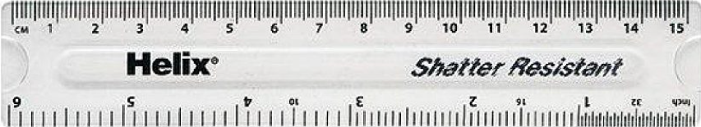
Optional ruler and protractor to use with previous slides

