Slide 1



Using the Resources Framework
to Understand
Student Misconceptions
in Science
Gethyn Jones
Teacher of Physics
Surbiton High School

Slide 2

What is the ‘Resources Framework’?
The Resources Framework is a theoretical framework commonly used by physics education researchers (e.g. Andrea di Sessa, David Hammer, Edward Redish and others).
It dynamically models student thinking as the activation of a number of cognitive resources.

Slide 3
An overview of the cognitive resources used in the Resources Framework
The ‘thinking resources’ used in the RF are:
Embodied cognition: this is the primitive, ‘base level’ layer of human thinking (e.g. ‘up is that way’)
Encyclopedic knowledge: this is the ‘learned knowledge’ layer (e.g. ‘up is away from the centre of the Earth’)
Contextualization: this is the ‘filtering’ layer that selects which cognitive resources to activate (e.g. ‘In Australia, which way is up?’)

Slide 4
The RF in the classroom
So far, so good . . .
The Red-Green-Blue or RGB model of the RF is a ”non-canonical” work-in-progress adaptation of the RF that I find useful in my classroom.
One reason I favour the RF(RGB) model is that it often suggests an approach that refines student preconceptions rather automatically classifying all preconceptions as unhelpful . . .

Slide 5

The RGB Model of the RF
The Embodied Cognition resource can be characterized as being made of straightforward generalizations of our everyday lived experience.
Some of these resources are what Di Sessa calls p-prims or phenomenological primitives.
In summary, embodied cognition is our ‘sense of mechanism’ – our intuitive sense of how the world works
EMBODIED
COGNITION
Notes:
Examples include:
The Ohm’s Law p-prim: if-resistance-increases-then-output-decreases
The Dynamic balance p-prim: two-opposing-effects-can-cancel-each-other-out

Slide 6

The RGB Model of the RF
The Encyclopedic Knowledge resource consists of a very large number of highly interconnected elements.
It is very rare for any one concept to be exclusively linked with only one other concept: they usually form part of a complex network.
In summary: the activation of one concept can lead to the activation of many other linked concepts in the ‘encyclopedic knowledge base’.
EMBODIED
COGNITION
ENCYCLOPEDIC KNOWLEDGE
Notes:
For example, the concept of ‘banana’ is dynamically linked with the concepts of ‘fruit’, ‘curved’, ‘yellow’ and ‘tastes-like-a-banana’
The equation u = v + at is dynamically linked with ‘physics’, ‘school’, ‘uniform-acceleration’, ‘Newtonian-dynamics’, and ‘instantaneous-velocity’

Slide 7

The RGB Model of the RF
Meaning is constructed dynamically from contextual and other clues.
In summary, contextualization is the process whereby cognitive resources are selected and activated to engage with the issue.
EMBODIED
COGNITION
CONTEXTUALIZATION
ENCYCLOPEDIC KNOWLEDGE
Notes:
The word ‘safe’ is linked to both ‘free-from-the-risk-of-harm’ and ‘unlikely-to-cause-harm’ concepts in our encyclopedic knowledge base.
The phrase “The child is safe” will prioritize the ‘free-from-the-risk-of-harm’ link whereas “The park is safe” will activate the ‘unlikely-to-cause-harm’ link.
However, a further contextual clue such “The developer’s bid was rejected, so the park is safe” will activate the ‘free-from-the-risk-of-harm’ link for the park

Slide 8

Modelling understanding using the RF(RGB)
“The park is safe.”
EMBODIED
COGNITION
CONTEXTUALIZATION
ENCYCLOPEDIC KNOWLEDGE
Notes:
Unlikely to cause injury
Free from the risk of harm

Slide 9
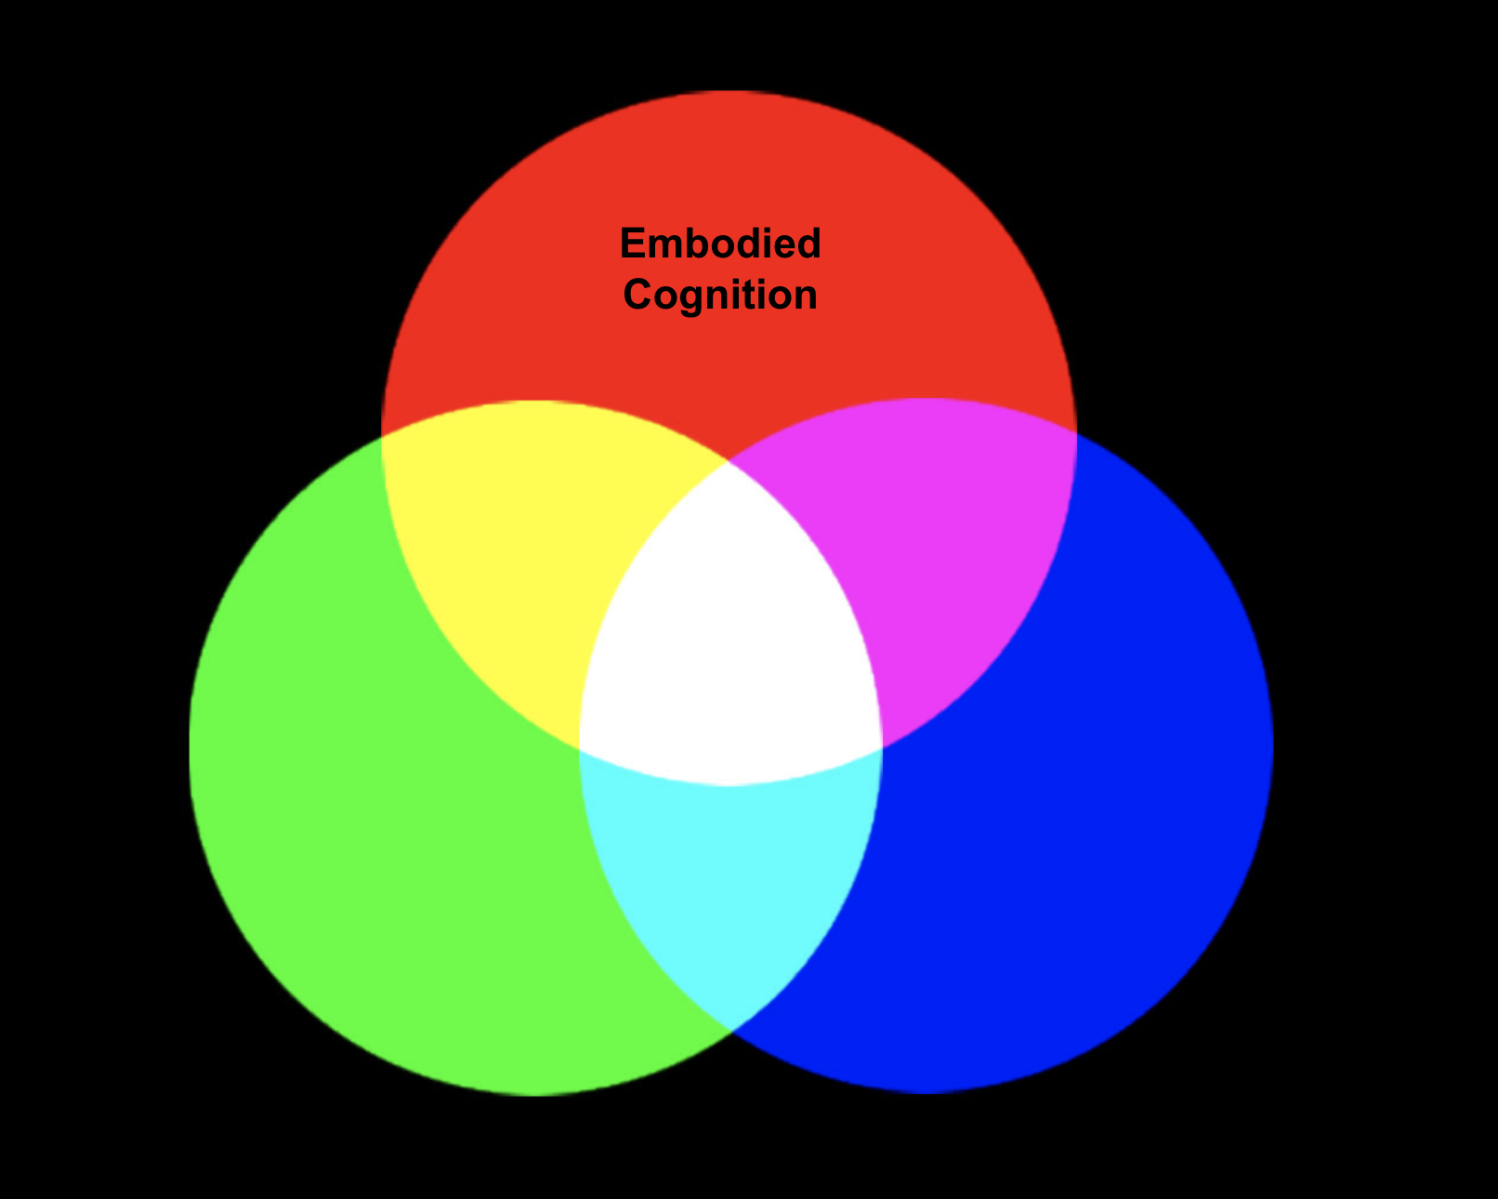
The RGB Model of the RF
Optimal
Understanding
Encyclopedic
Knowledge
Contextualization

Slide 10
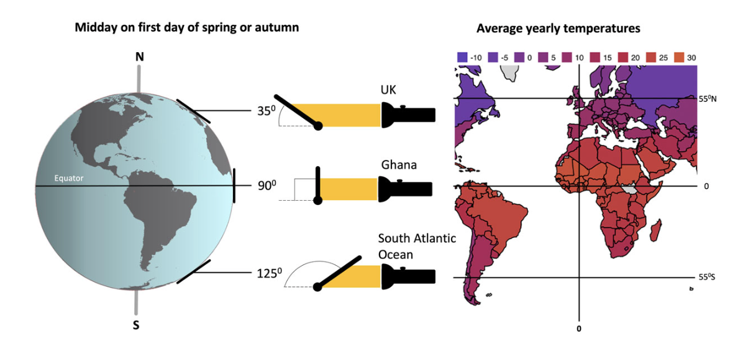
Analyzing student preconceptions using the RF(RGB) 1a
“The Earth has seasons because its orbit is elliptical: it is closer to the Sun in summer and further away in winter.”
Sub-optimal understanding
Zone
1
Optimal
Understanding
Encyclopedic
Knowledge
Contextualization
Notes:
To address this, the RF(RGB) suggests a two pronged approach to refine the contextualisation process.
Firstly, we should address the incorrect selection of encyclopedic knowledge. The Earth’s orbit is elliptical but the changing Earth-Sun distance cannot explain the seasons because (1) the point of closest approach is around Jan 4th (perihelion) which is winter in the northern hemisphere; (2) seasons in the northern and southern hemispheres do not match; and (3) the Earth orbit is very nearly circular with an eccentricity e of 0.0167 where a perfect circle has e = 0.
Secondly, the closer-is-warmer p-prim is not the best embodied cognition resource to activate. Rather, we should seek to activate the spread-out-is-less-intense ‘sense of mechanism’ as far as we are able to

Slide 11
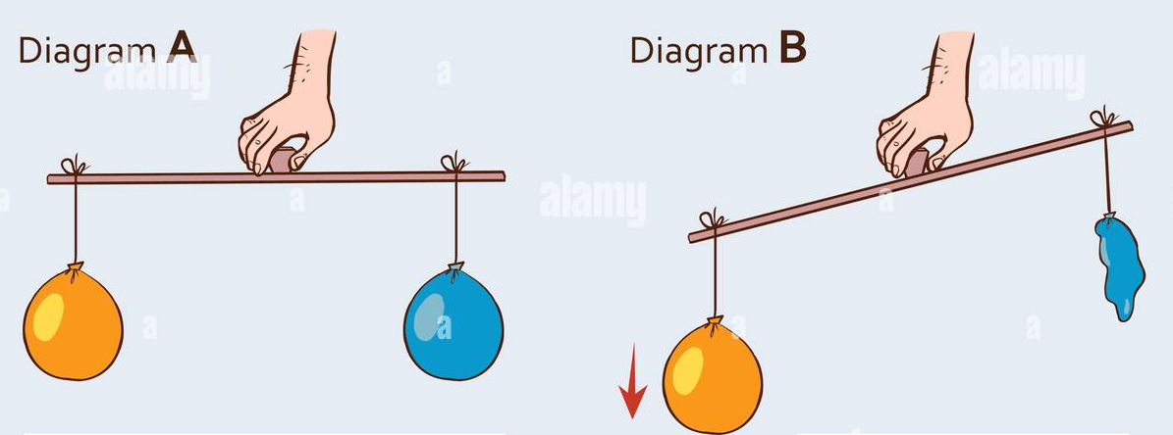
Analyzing student preconceptions using the RF(RGB) 1b
“As a plant grows, it increases in mass and the soil decreases in mass.”
Sub-optimal understanding
Zone
1
Optimal
Understanding
Encyclopedic
Knowledge
Contextualization
Notes:
Sub-optimal understanding because of the embodied cognition that gases have virtually no mass and also because of the encyclodpedic knowledge that plant absorb nutrients through their roots
To address this:
seek to activate the encyclopedic knowledge that the mass of the soil does not change as the plant grows
establish that gases have a measurable mass.

Slide 12
Analyzing student preconceptions using the RF(RGB) 2a
“All water waves behave like the waves on the beach so water is carried along with the wave.”
Sub-optimal understanding
Zone
2
Optimal
Understanding
Encyclopedic
Knowledge
Contextualization
Notes:
The structure of this preconception could be broken down into:
Embodied cognition: if I stand close to the water on a beach, then the waves move forward to wash over my feet.
Encyclopaedic knowledge: the waves observed on a beach are water waves
Considered in isolation, both of these cognitive resources are unproblematic: they accurately describes our everyday, lived experience. It is the contextualisation process that leads us to apply the resources inappropriately and places us squarely in Suboptimal Understanding Zone 2.
The RF(RGB) Model suggests that we can address this issue in two ways.
Firstly, we could seek to activate a more useful embodied cognition resource by re-contextualising. For example, we could ask students to imagine themselves floating in deep water far from the shore: do the waves carry them in any particular direction or simply move them up or down as they pass by?
Secondly, we could seek to augment their encyclopaedic knowledge: yes, the waves on a beach are water waves but they are not typical water waves. The slope of the beach slows down the bottom part of the wave so the top part moves faster and ‘topples over’ — in other words, the water waves ‘break’ leading to what appears to be a rhythmic back-and-forth flow of the waves rather than a wave train of crests and troughs arriving a constant wave speed. (This analysis is over a short period of time where the effect of any tidal effects is negligible.)
Both processes try to ‘tug’ student understanding into the central, optimal zone.

Slide 13
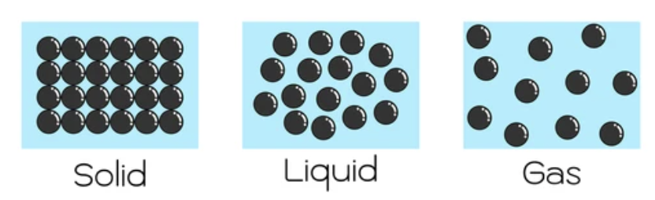
Analyzing student preconceptions using the RF(RGB) 2b
“There are spaces between the particles of a liquid.”
Sub-optimal understanding
Zone
2
Optimal
Understanding
Encyclopedic
Knowledge
Contextualization
Notes:
The structure of this preconception could be broken down into:
Embodied cognition: The properties of a liquid are “halfway” between the properties of a solid and a gas. Solid – liquid – gas phases form a continuum.
The phases of matter are discontinuous: something is either a solid or a liquid or a gas – there are no “halfway” or combination states.
Encyclopedic knowledge: ‘Spaces between particles’ model in incompatible with the fact that liquids are incompressible.

Slide 14
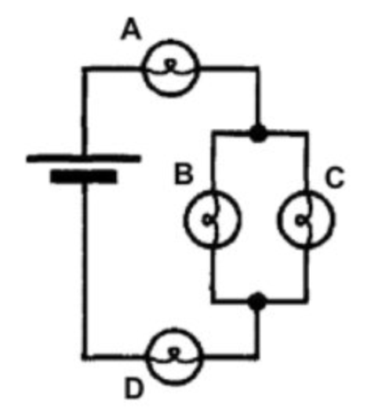
Analyzing student preconceptions using the RF(RGB) 3a
Optimal
Understanding
Student unable to use Kirchoff’s circuit laws to account for the varying brightness of the bulbs.
Encyclopedic
Knowledge
Contextualization
Sub-optimal understanding
Zone
3
Notes:
The student said that they had spent nearly an hour trying to set up and solve the Kirchoff’s Law loop equations to address this problem but had been unsuccessful in accounting for the varying brightnesses.
Redish suggested to the student that they try an analysis ‘without the equations’ and just look at the problems in simpler physical terms using just the concept of electric current. Since current is conserved it must split up to pass through bulbs B and C. Since the brightness is dependent on the current, the smaller currents in B and C compared with A and D accounts for their reduced brightness.
When he was introduced to [this] approach to using the basic principles, he lit up and was able to solve the problem quickly and easily, saying, ‘‘Why weren’t we shown this way to do it?’’ He would still need to bring his conceptual understanding into line with the mathematical reasoning needed to set up more complex problems, but the conceptual base made sense to him as a starting point in a way that the algorithmic math did not.
Analysing this issue using the RF(RGB) it is plausible to suppose that the student was trapped in Suboptimal Understanding Zone 3. They had correctly selected the Kirchoff’s Law resources from their encyclopedic knowledge base, but lacked a ‘sense of mechanism’ to correctly apply them.
What Redish did was suggest using an embodied cognition resource (the idea of a ‘material flow’) to analyse the problem more productively. As Redish notes, this wouldn’t necessarily be helpful for more advanced and complex problems, but is probably pedagogically indispensable for developing a secure understanding of Kirchoff’s Laws in the first place.

Slide 15
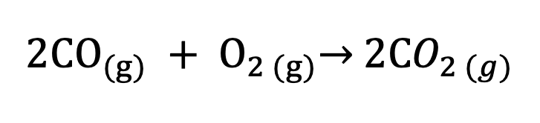
Analyzing student preconceptions using the RF(RGB) 3b
$$2CO_{(g)} + O_{2 (g)}\underset{→}{ } 2CO_{2 (g)}$$
5 grams
0.18 mol
13 grams
0.41 mol
18 grams
0.41 mol
In unstructured interviews, BouJaoude and Barakat (2003) found that 66% of students were not able to calculate the correct mass of carbon dioxide for this reaction.
Many students assumed that the entire 18 g of the product would be carbon dioxide.
Optimal
Understanding
Encyclopedic
Knowledge
Contextualization
Sub-optimal understanding
Zone
3
Notes:
0.18 mol of CO2 is produced having a mass of 7.92 g
0.09 mol of the O2 reacts leaving 0.32 mol / 10.24 g of unreacted oxygen.
The students may be lost in “algorithmic space” and need some embodied cognition about the physical meaning of the equation to understand that the limiting factor here is the amount of carbon dioxide.

Slide 16
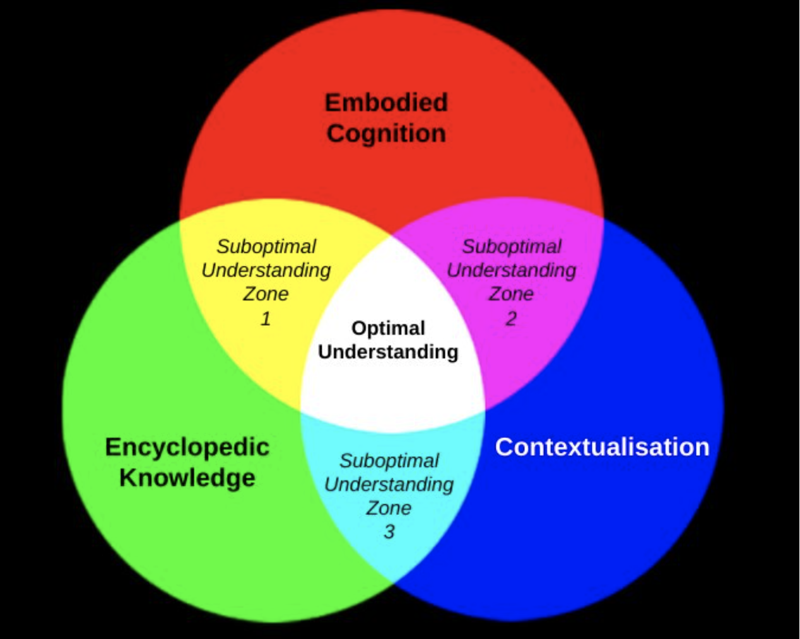
Conclusion
The Resources Framework provides much food for thought and fascinating reading for all science teachers (see Redish and Kuo 2015 for a concise introduction).
The RF(RGB) provides a possible vehicle for the application of the RF to a range of student preconceptions
This analysis can suggest productive teaching approaches to address these preconceptions.

Slide 17
References
Redish, E. F., & Kuo, E. (2015). Language of physics, language of math: Disciplinary culture and dynamic epistemology. Science & Education, 24(5), 561-590.
BouJaoude, S., & Barakat, H. (2003). Students' problem solving strategies in stoichiometry and their relationships to conceptual understanding and learning approaches. The Electronic Journal for Research in Science & Mathematics Education.
Acknowledgement
Thank to https://www.physicsclassroom.com/ for the excellent colour addition simulation

Slide 18

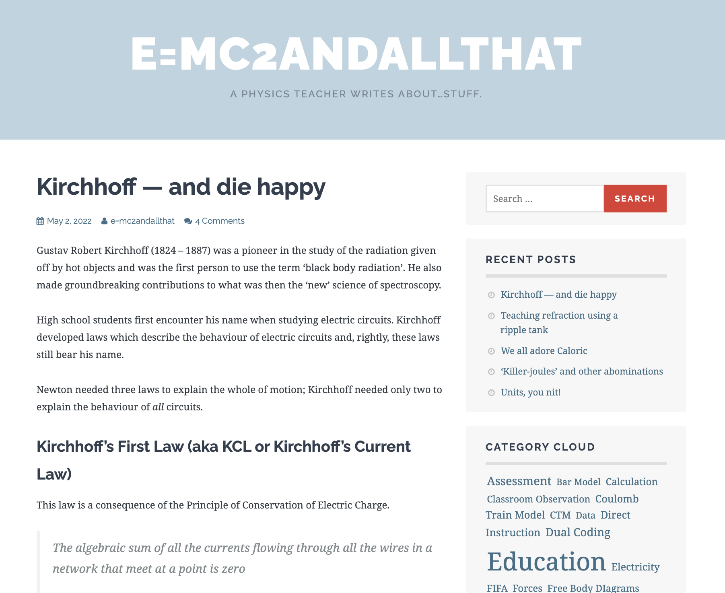
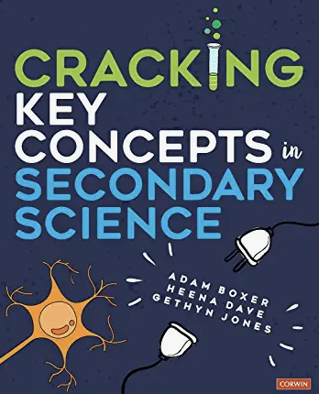

More from me . . .
Blog | Books | Twitter
https://physicsteacher.blog/ | Cracking Key Concepts in Secondary Science (co-authored with Adam Boxer and Heena Dave) The ResearchED Guide to Explicit and Direct Instruction (Chapter on example-sets)

