Slide 1
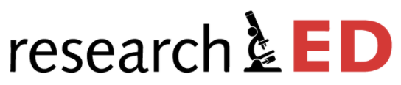
Dealing with Misconceptions: p-prims and the ‘refining raw intuitions’ approach
2021
Gethyn Jones
Teacher of Physics, Surbiton High School
Twitter: @emc2andallthat
Blog: physicsteacher.blog
Co-author of ‘Cracking Key Concepts in Secondary Science’

Slide 2
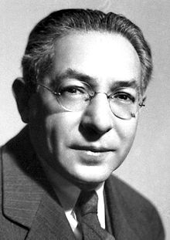
Who ordered that?
Isidor Isaac Rabi’s (1898-1988) famous response to the discovery of the muon (c.1936)

Slide 3
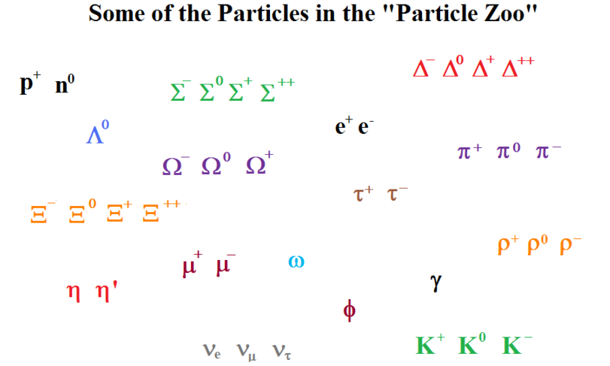
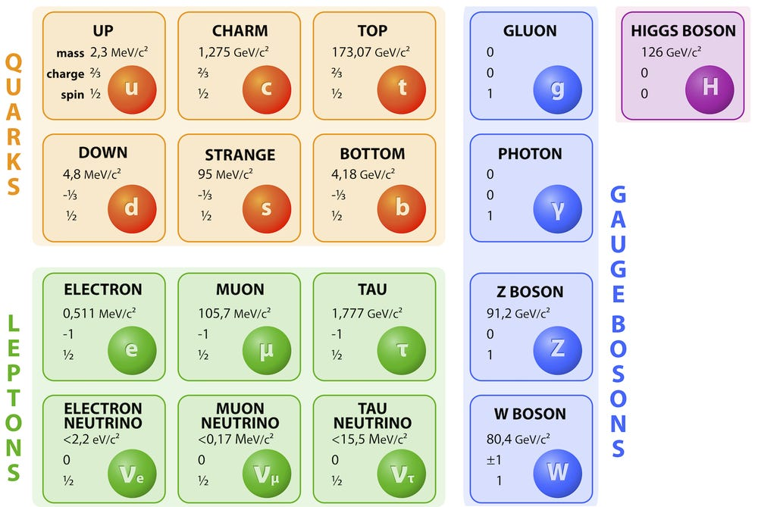
simplified
The Standard Model

Slide 4
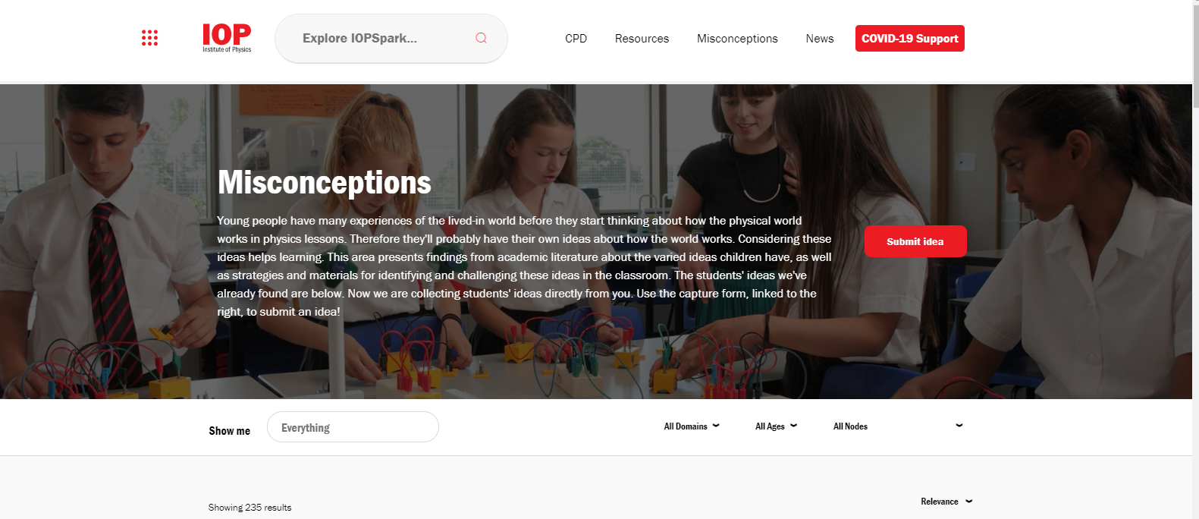

Simplified?
The Resources Framework
PER* Community e.g.
  Andrea Di Sessa
  David Hammer
  Edward Redish
*Physics Education Research

Slide 5
Redish and Kuo (2015) suggest three ‘lenses’ to view how students construct meaning in physics.
Embodied cognition: Phenomenological primitives (p-prims) tie basic physics reasoning to embodied experience e.g. ‘What goes up must come down’.
Encyclopaedic knowledge: Varied productive resources are used dynamically e.g. previous knowledge, sources taken to be authoritative, calculation and so on.
Contextualization: Activation depends on conceptual, epistemological, and affective factors e.g. “Who are you going to trust, me or your lying eyes?”

Slide 6
Redish and Kuo (2015) suggest three ‘lenses’ to view how students construct meaning in physics.
Embodied cognition: Phenomenological primitives (p-prims) tie basic physics reasoning to embodied experience e.g. ‘What goes up must come down’.
Encyclopaedic knowledge: Manifold productive resources are used dynamically e.g. previous knowledge, sources taken to be authoritative, calculation and so on.
Contextualization: Activation depends on conceptual, epistemological, and affective factors e.g. “Who are you going to trust, me or your lying eyes?”

Slide 7
What is a p-prim?
P-prims or phenomenological primitives
‘are simple abstractions from common experiences that are taken as relatively primitive in the sense that they generally need no explanation; they simply happen.’
-- Andrea Di Sesssa (1988)
Notes:
So let’s look at a p-prim in action

Slide 8
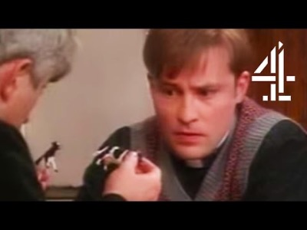
The ‘Father Dougal’ p-prim

Slide 9


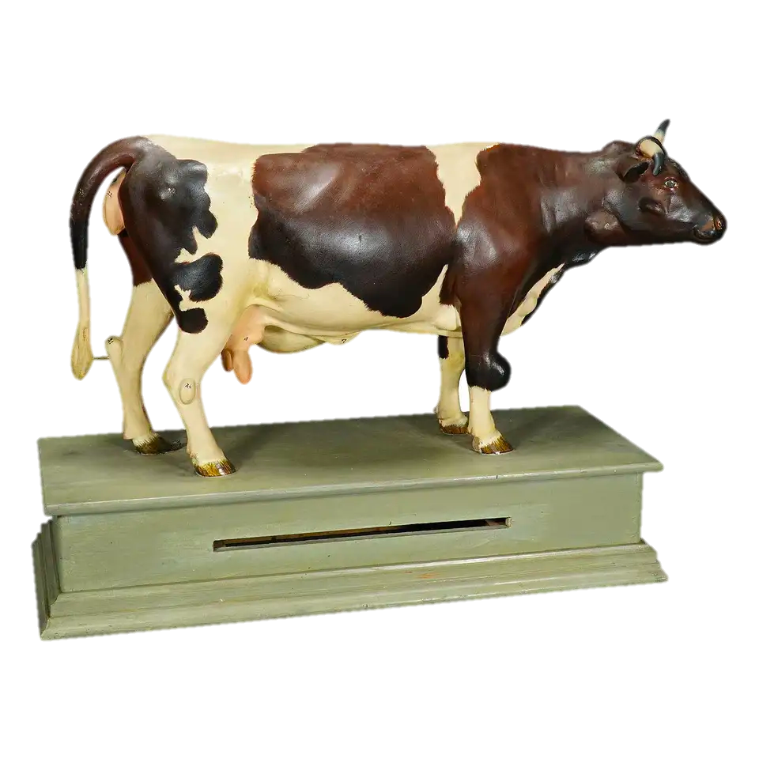
The ‘Father Dougal’ p-prim
Cow A is the same size as cow B
A
B

Slide 10
Through a p-prim, darkly
P-prims are are not misconceptions, but they can generate misconceptions when they are wrongly applied.
A p-prim is like a semi-transparent filter: the world may look ‘wrong’ when viewed through it, but only when we look out through the ‘wrong’ p-prim
For p-prims, context is everything.

Slide 11
The ‘Father Dougal’ p-prim
P-prim filter
Big objects look big, small objects look small
A
B

Slide 12



Applying the ‘Father Dougal’ P-prim

Slide 13

Di Sessa (1993) provides a list of p-prims. These include:
Ohm’s p-prim: ‘output’ decreases as ‘resistance’ increases
Dying away: all effects spontaneously decrease in amplitude
Passive resistance: objects can passively resist or block motion without exerting a force

Slide 14
Hammer (2000) suggests that we should think of teaching as ‘refining’ rather than ‘replacing’ raw intuitions.

Slide 15
Springs and Things

Slide 16
Springs and Things

Slide 17
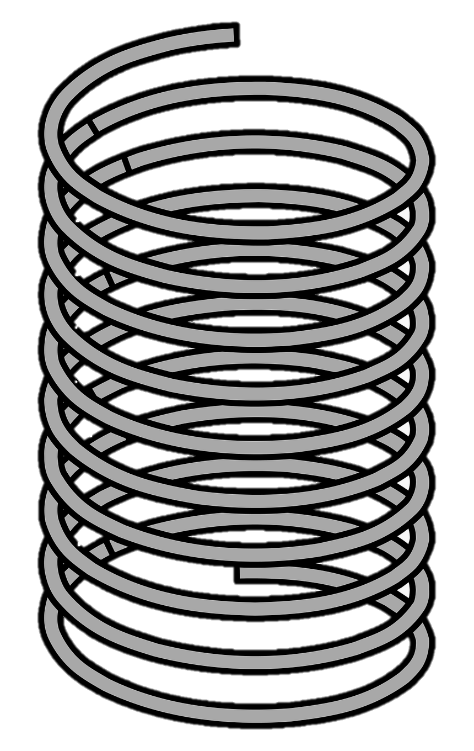
Springs and Things

Slide 18
Springs and Things

Slide 19
Springs and Things

Slide 20
Springs and Things

Slide 21
Springs and Things

Slide 22
Other Examples
Cues up the Ohm’s p-prim: as x increases, y decreases

Slide 23
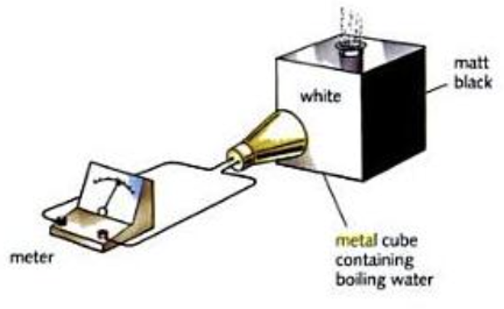
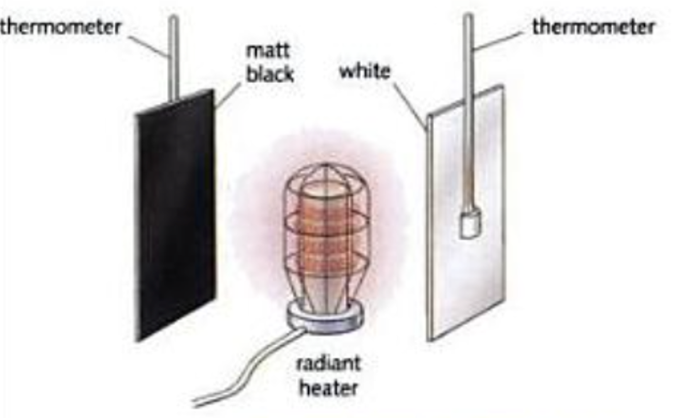
Other Examples
“Wait, you say that black is a good emitter and a good absorber….?”
Cues up the Ohm’s p-prim: as x increases, y decreases

Slide 24
Other Examples
“Wait, you say that black is a good emitter and a good absorber….?”
Nelmes (2004) suggests cueing an alternative p-prim (sometimes called ‘the Matthew Effect’ p-prim) by considering examples such as: “A good communicator is good at listening and speaking”.
Cues up the Ohm’s p-prim: as x increases, y decreases

Slide 25
Conclusion
Misconceptions research in education has been hugely valuable:
  For many teachers, it is the educational research that has the most immediate and tangible practical benefit.
  It emphasizes the fact that students’ prior knowledge is important.
The downside of misconceptions research as it is sometimes applied is that it emphasizes the negative impact of students’ prior knowledge: nasty, messy everyday thinking is be rooted out and replaced by brand new shiny proper scientific thinking.
P-prims and the Resources Framework offer a promising alternative: a sympathetic awareness of student thinking that could improve teaching and learning in science.

Slide 26
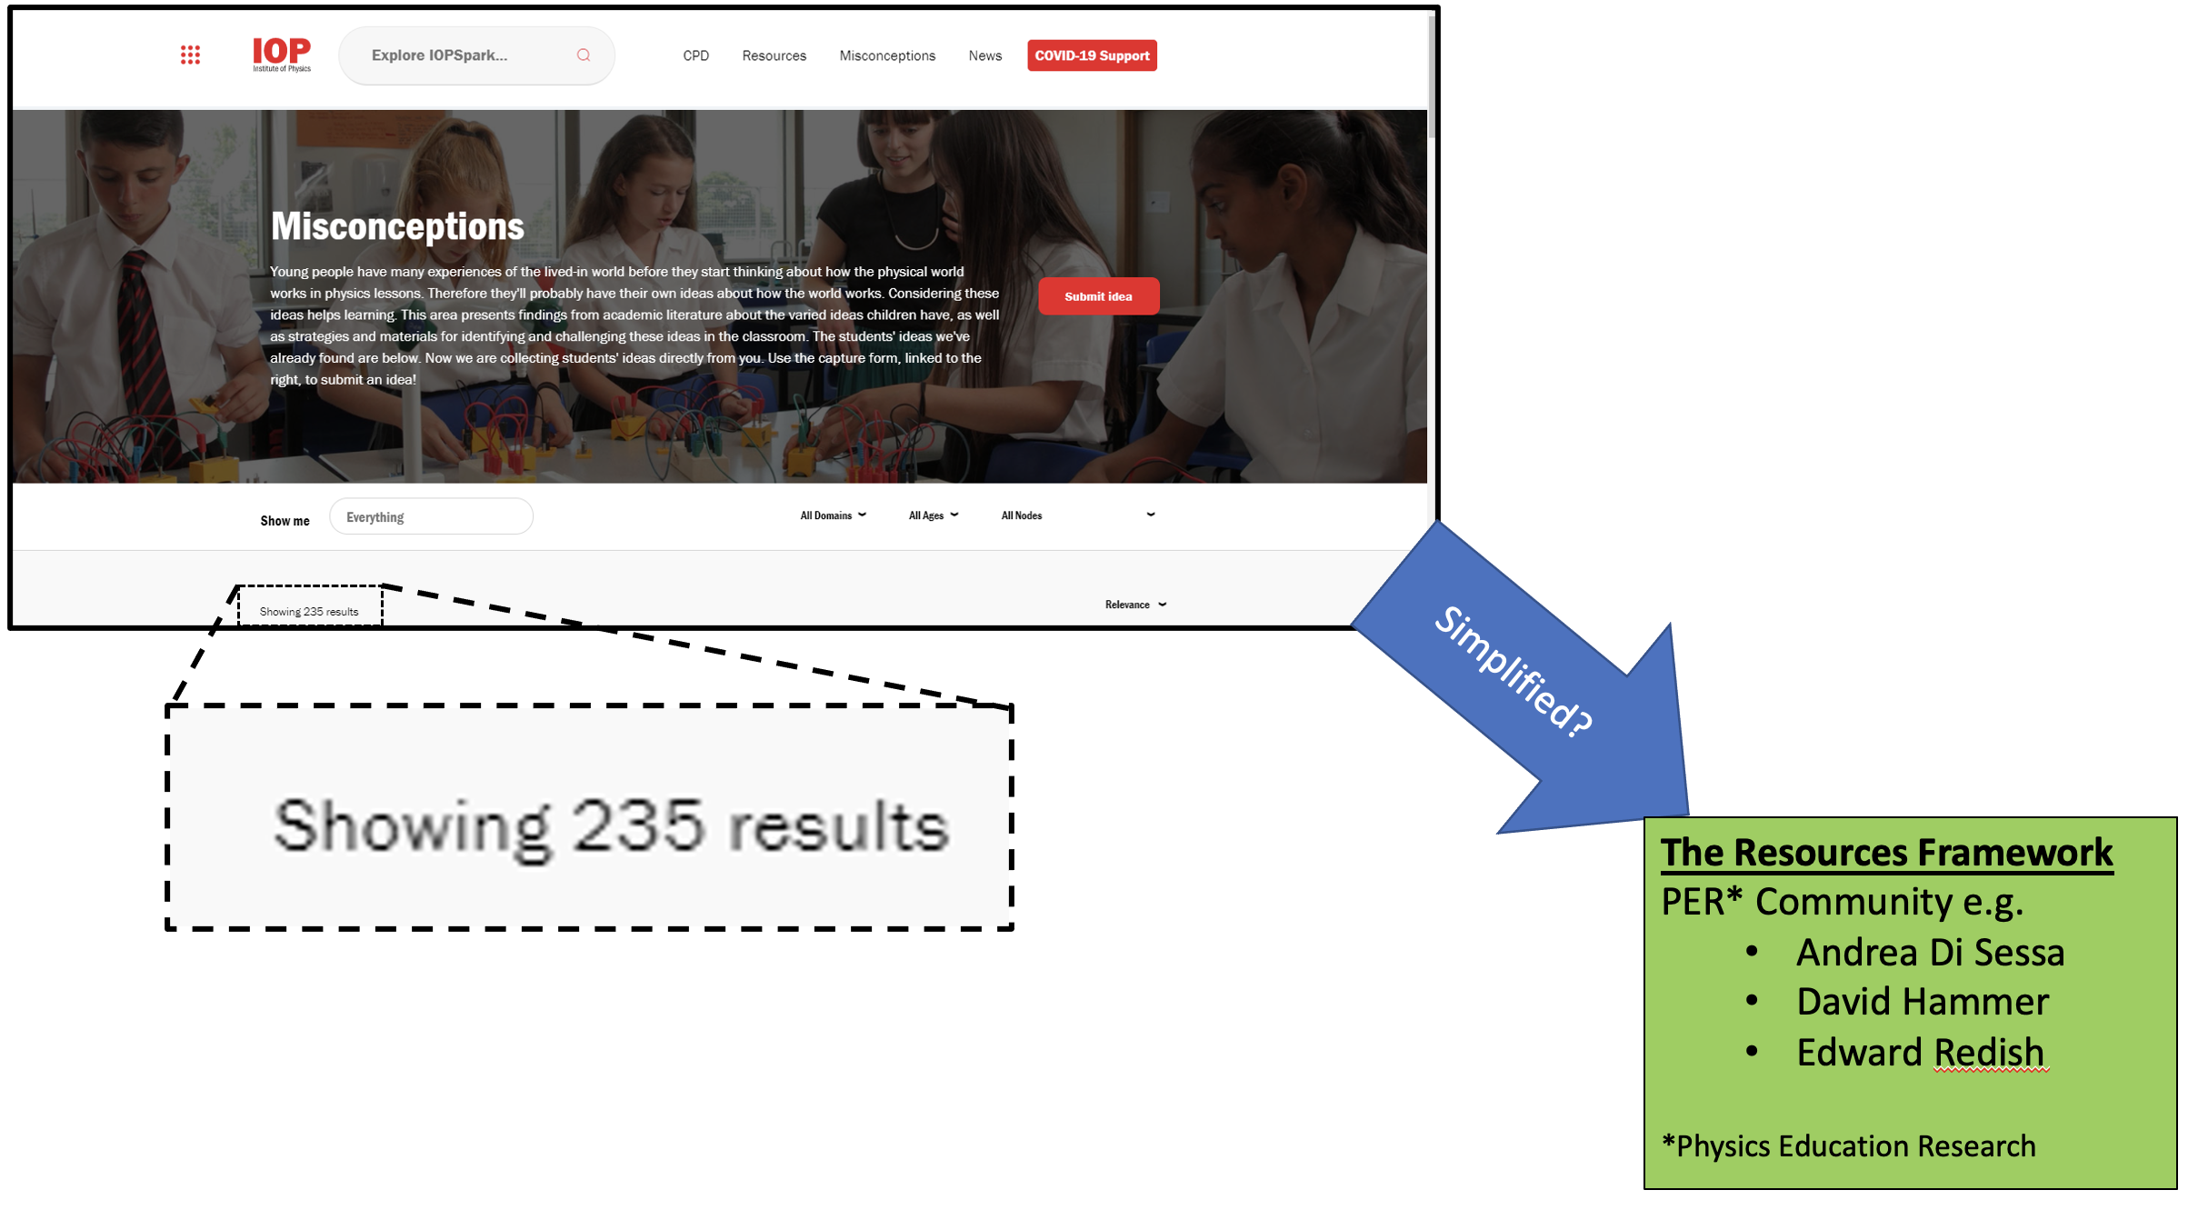
Closing Thought
Will a ‘Standard Model’ Theory of student misconceptions in science ever be developed….?

Slide 27
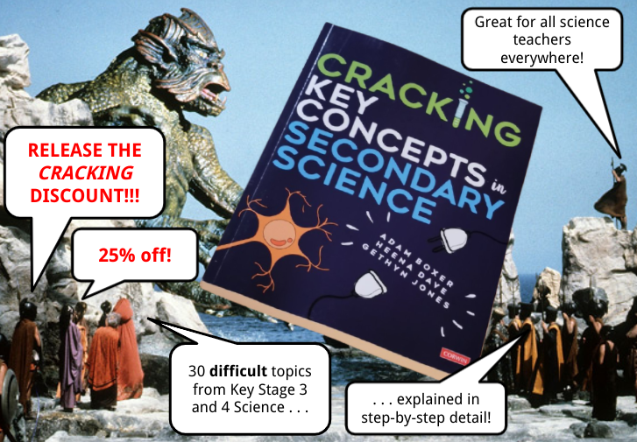
To claim your discount:
Go to https://uk.sagepub.com
Search for 'Cracking’
Enter the discount code 'UK21AUTHOR' at Checkout.
Wait for Royal Mail to deliver your copy post-haste.
Enjoy!

Slide 28
References
diSessa, A. A. (1988). Knowledge in pieces. In G. Forman & P. B. Pufall (Eds.), Constructivism in the computer age (pp. 49–70). Lawrence Erlbaum Associates, Inc.
DiSessa, A. A. (1993). Toward an epistemology of physics. Cognition and instruction, 10(2-3), 105-225.
Hammer, D. (2000). Student resources for learning introductory physics. American Journal of Physics, 68(S1), S52-S59.
Nelmes, A. (2004). Putting conceptions in their place: using analogy to cue and strengthen scientifically correct conceptions.
Redish, E. F., & Kuo, E. (2015). Language of physics, language of math: Disciplinary culture and dynamic epistemology. Science & Education, 24(5), 561-590.

